Slide 1




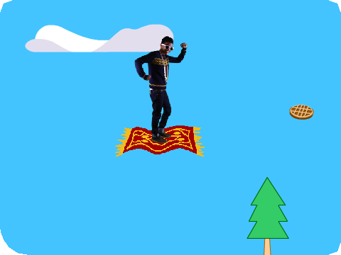
Make It Fly Cards
Choose any character and make it fly!
scratch.mit.edu/fly

Slide 2

Make It Fly Cards
Use these cards in this order:
Choose a Character Start Flying
Switch Looks Move with Keys Floating Clouds Flying Hearts
1
2
3
4
5
6
7 Collect Points
scratch.mit.edu/fly

Slide 3




Choose a Character
Choose a character to fly.
Make It Fly
1

Slide 4



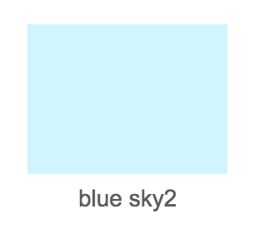

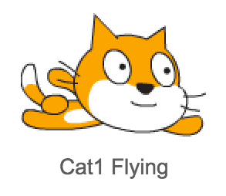
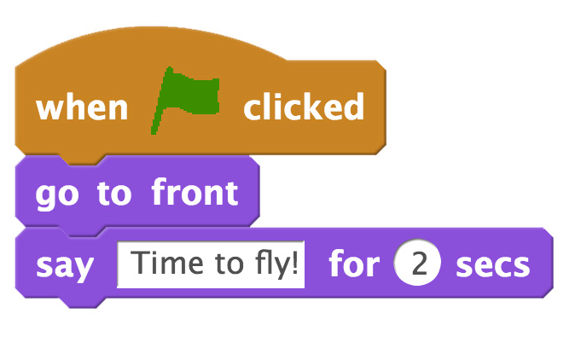

Choose a Character
scratch.mit.edu/fly
GET READY
Choose a backdrop.
Choose a sprite from the Flying theme.
ADD THIS CODE
Type what you want your sprite to say.
TRY IT
Click the green flag to start

Slide 5
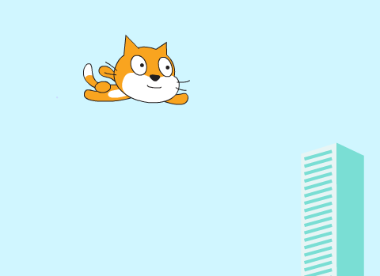

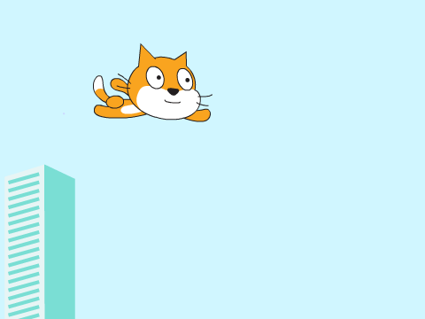
Start Flying
Move the scenery so your character looks like it’s flying.
Make It Fly
2

Slide 6



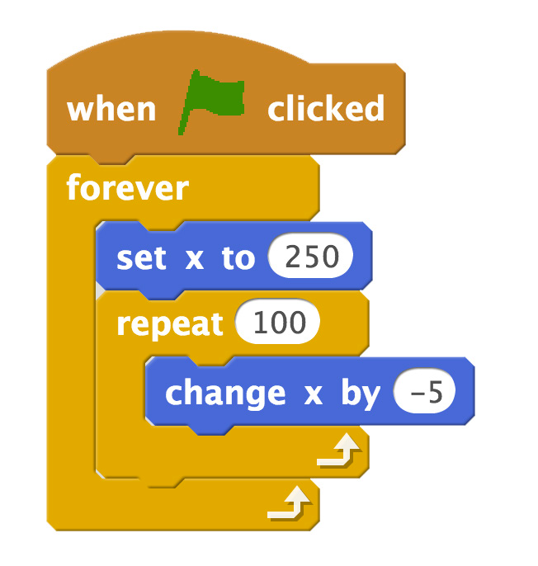
Start Flying
scratch.mit.edu/fly
GET READY
Choose a sprite to fly by, such as Buildings.
ADD THIS CODE
Start from the right end of the stage.
Type a negative number to move left.
TIP
x is the position on the Stage from left to right.
y = 180
x = -240
x = 240
y = -180

Slide 7
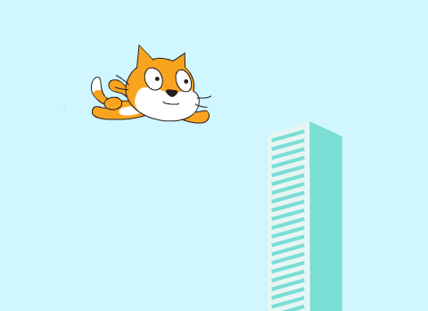
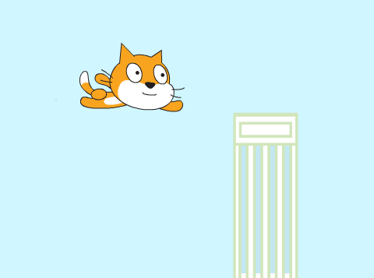

Switch Looks
Add variety to your scenery.
Make It Fly
3

Slide 8

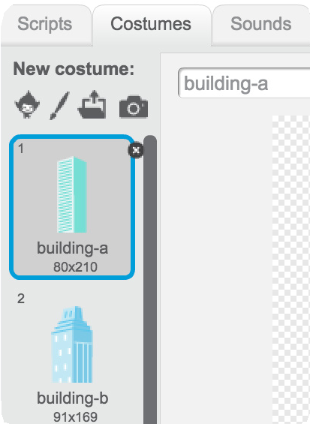
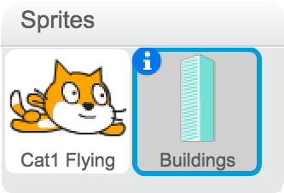
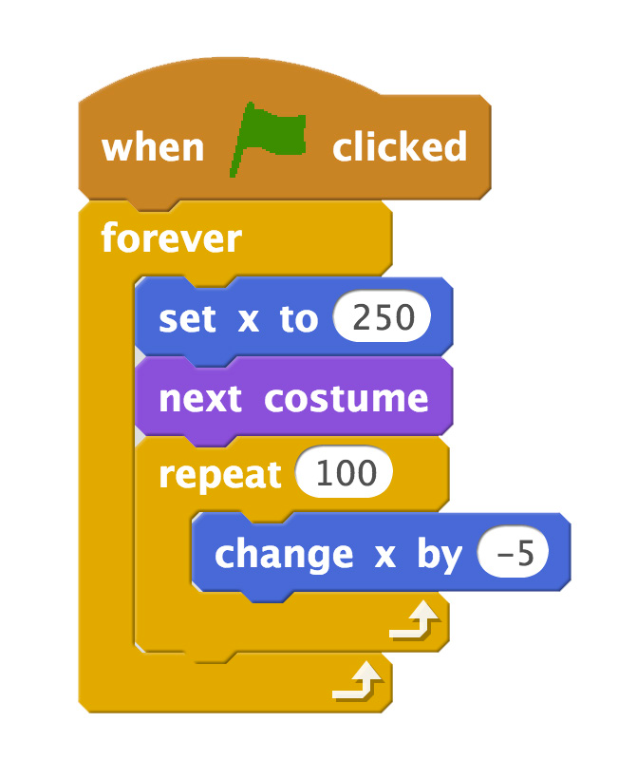



Switch Looks
scratch.mit.edu/fly
GET READY
Click to select the
Buildings sprite.
Then, click the Costumes tab to see different costumes.
ADD THIS CODE
Click the
tab.
Add this block to switch costumes.
TRY IT
Click the green flag to start

Slide 9
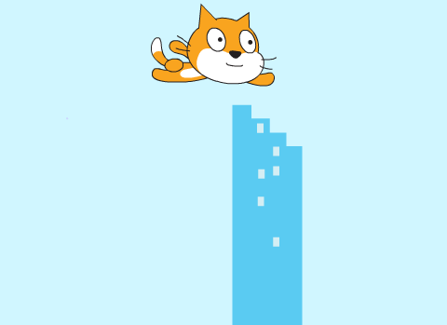
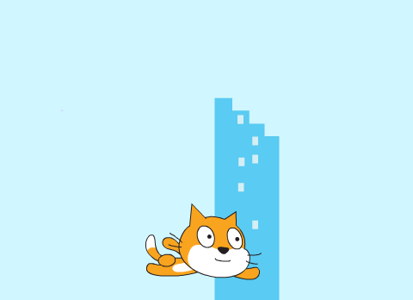
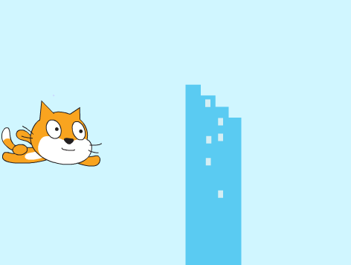
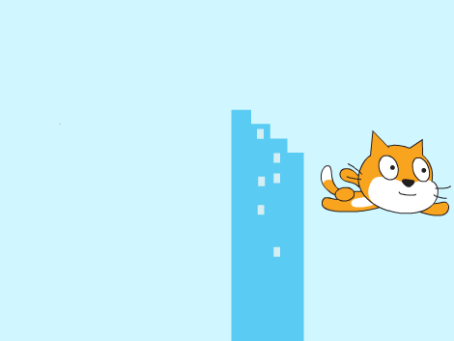
Make It Interactive
Make your character move when you press a key.
Make It Fly
4

Slide 10
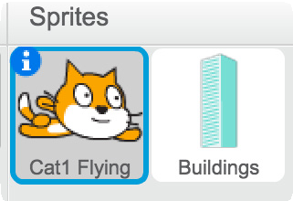
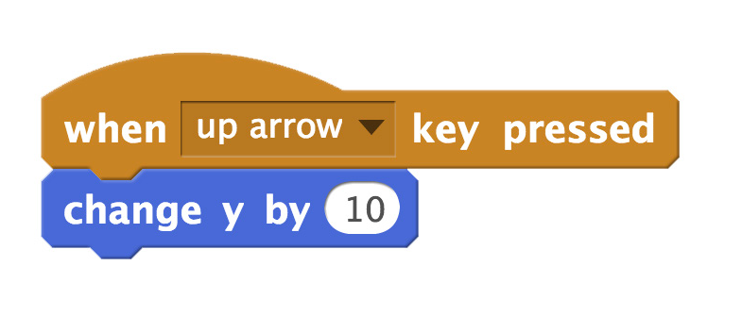
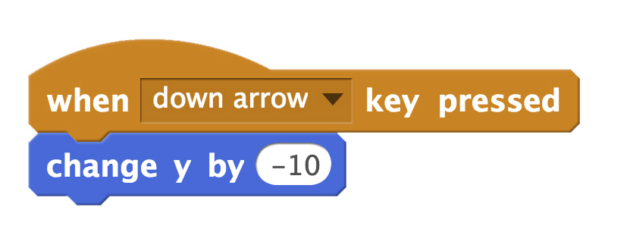
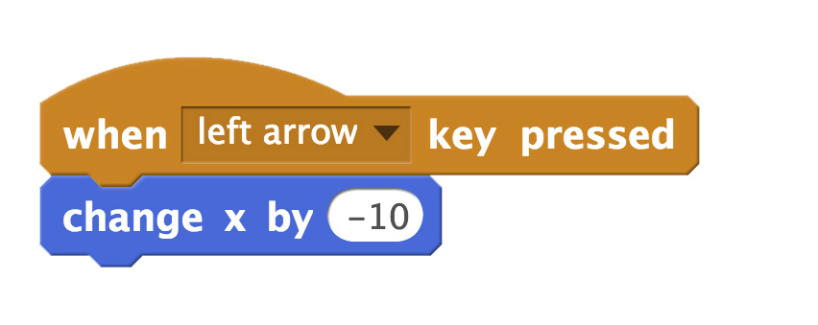
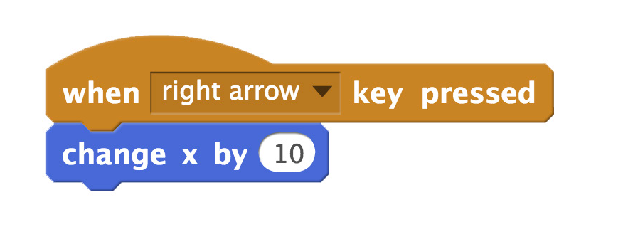
Make It Interactive
scratch.mit.edu/fly
GET READY
Click to select your flying sprite.
ADD THIS CODE
TRY IT
Press the arrow keys on your keyboard to make your character move.

Slide 11
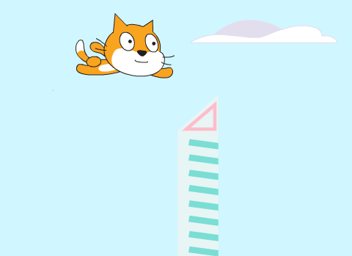
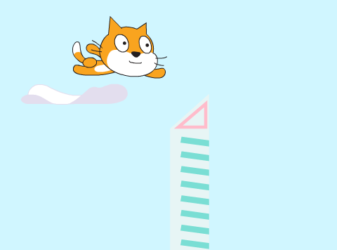
Floating Clouds
Make clouds float by in the sky!
Make It Fly
5

Slide 12



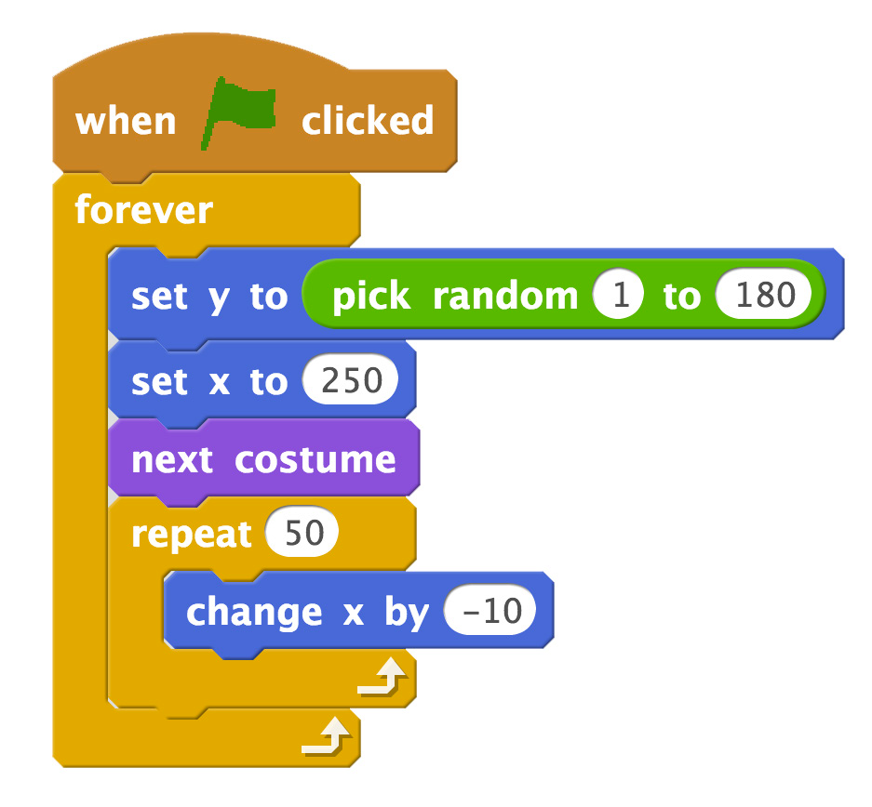
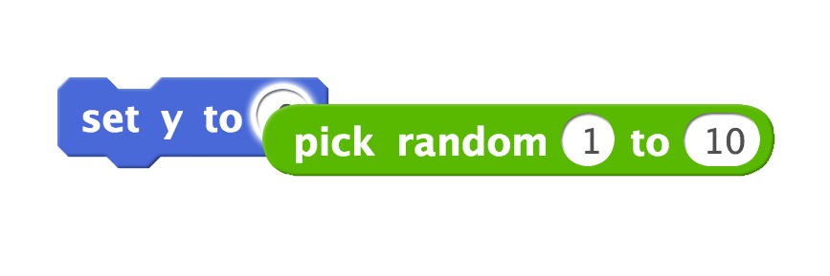
Floating Clouds
scratch.mit.edu/fly
GET READY
Choose Clouds from the library.
ADD THIS CODE
Drag the pick random block into the set y to block.
Type 180 to keep Clouds in top half.
TIP
y is the position on the Stage from top to bottom.
y = 180
x = -240
x = 240
y = -180

Slide 13

Flying Hearts
Add hearts or other floating objects to collect.
Make It Fly
6

Slide 14


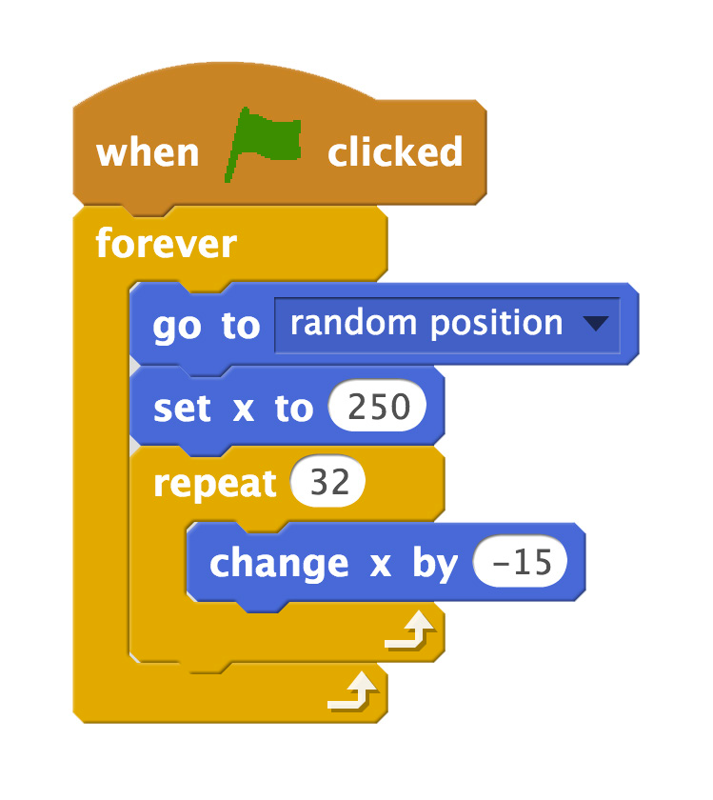
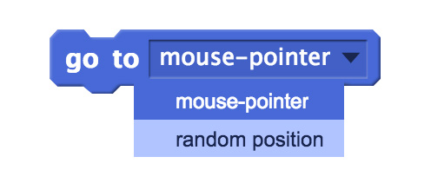

Flying Hearts
scratch.mit.edu/fly
GET READY
Choose a sprite, such as Heart.
ADD THIS CODE
Choose random position from the menu.
TRY IT
Click the green flag to start

Slide 15

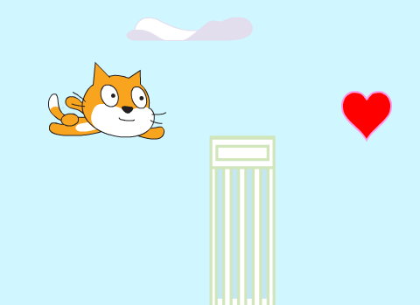

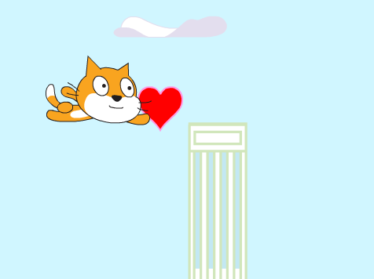
Collect Points
Add a point each time you touch a heart or other object.
Make It Fly
7

Slide 16
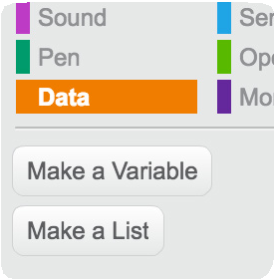
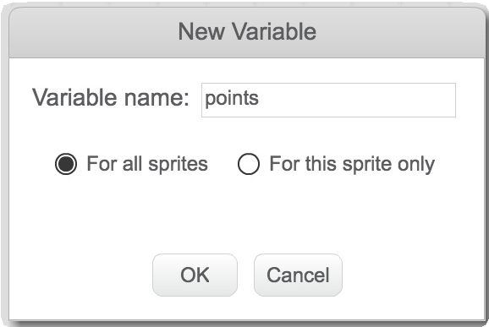
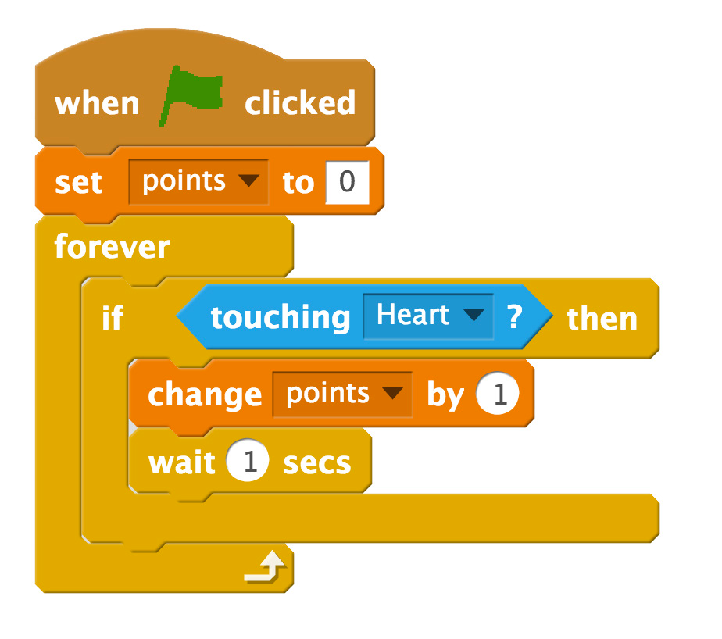
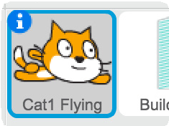

Collect Points
scratch.mit.edu/fly
GET READY
Choose Data
Click the Make a Variable button.
Name this variable points
and then click OK.
ADD THIS CODE
Reset points at the start.
Select your flying sprite.
Choose Heart from the menu.
Add a point.
TRY IT
Click the green flag to start

